Slide 1

Module 6.2
Finding information

Slide 2
Contents
Introduction
Determine what information you need
Step 1: Investigate what is given
Step 2: Describe the task
Step 3: Identify the information you have to find
Activity 1
Find the information and save it
Decide about resources
Save the data, facts and information that you find
Activity 2
Test and improve

Slide 3
Introduction
Finding information (6.2)
Using and processing information (6.3)
Presenting solutions and information (6.3)

Slide 4
Determine what information you need
Investigate what is given
Describe the task
Read through problem
Highlight important facts
Identify all the parts
Ask questions: What? Where? When? How? Why?
Determine what is given
Determine what must be done
Determine what the result should be
Identify the information you have to find
Format: Write down what the task should look like
Content: Write down what you have to investigate – the focus question
Ask more questions
Sort the questions
Adjust questions where necessary

Slide 5
Determine what information you need
Step 1: Investigate what is given
The CAT class wants to start a WhatsApp group, but some parents are unhappy about it
Given
Create an info brochure to inform parents about WhatsApp, and to put them at ease
Needed

Slide 6
Determine what information you need
Step 2: Describe the task
Format
HOW it is to be presented (e.g. report, brochure, poster, presentation)
WHO it is intended for (the target audience)
Content
The PROBLEM you have to solve or the TASK you have to complete

Slide 7
Determine what information you need
Step 3: Identify the information you have to find
Write down all the questions you can think of and place them in the right category in your table
?
Look at your questions carefully
Some questions are unnecessary – erase them
Some answers are obvious – write them down
Some answers you do not have yet. Work with this group now to find the answers

Slide 8
Determine what information you need
Possible paragraph headings | Questions | Sources
Introduction | Why do learners use WhatsApp?
 | How many learners already use WhatsApp?
 | How many learners use WhatsApp for school work?
 | What are the WhatsApp groups used for?
 | Why are parents suspicious of WhatsApp?
Basic information | What is WhatsApp?
 | What does one need?
 | Can anyone use WhatsApp?
 | What is the purpose of WhatsApp?
Advantages of WhatsApp | Why is WhatsApp so popular?
 | What are the advantages?
 | How can WhatsApp help me as a CAT learner?
 | What if teachers and learners all use WhatsApp?
Dangers of WhatsApp | What are the risks of using WhatsApp?
How to use WhatsApp safely | What advice to WhatsApp users for their protection?
Conclusion

Slide 9

Activity 1

Slide 10
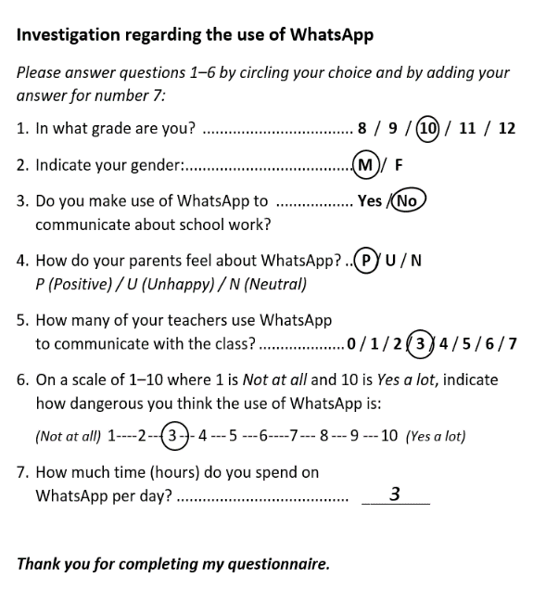

Find the information and save it
Decide about resources
Electronic media
Printed media – books, magazines and newspapers
Interviews / questionnaires

Slide 11
Tips for setting good questionnaires
Make sure your questions can have only one answer
If asked how many hours learners spend on Facebook, the answers can be varied. Give specific categories
How does parents feel about Facebook? Give them a scale from 1–5 to rate their feelings
0-2 hrs per day
2-4 hrs per day
More than 4 hrs per day
Definitely do not like it
Mostly do not like it
Neutral
Mostly like it
Definitely like it

Slide 12
Save the data, facts and information that you find
Strategies you can use:
Type researched information in a Word document
Save copies of web pages in a folder structure
Make notes of interviews / record interviews with your smartphone or video camera
Place copies and clippings in a file
Create a summary table to help you to keep track of the information

Slide 13
Save the data, facts and information that you find
Summary table should have these headings:
Question
Title of book / webpage / opinion poll
Author / group used for opinion poll
URL (if web page used) / Author (if book used)
Date updated / published / created
Short summary of the information, or a link to place where it is saved
Reliable (yes / no) – give reason

Slide 14
Activity 2

Slide 15
Test and improve your knowledge
Read the assignment carefully before you start
Underline or highlight important information
Ask questions
Describe problem in own words
Questions in table
Save / keep all data, facts and info

